Slide 1
计算机体系结构
GPGPU

Slide 2
Review
单发射Tumasulo + 推断执行， superscalar, VLIW, Fined-grained MT (FGMT), coarse-grained MT, CMP, SMT, vector
哪个的概念和实现还不清楚、需要重新过一遍？

Slide 3
Review
向量机的存储器访问
存储器组织：独立存储体、多体交叉方式
Stride : 固定步长（1 or 常数）, 非固定步长（index）
基于向量机模型的优化
链接技术
有条件执行
稀疏矩阵的操作
多媒体扩展指令
扩展的指令类型较少
向量寄存器长度较短
GPU

Slide 4
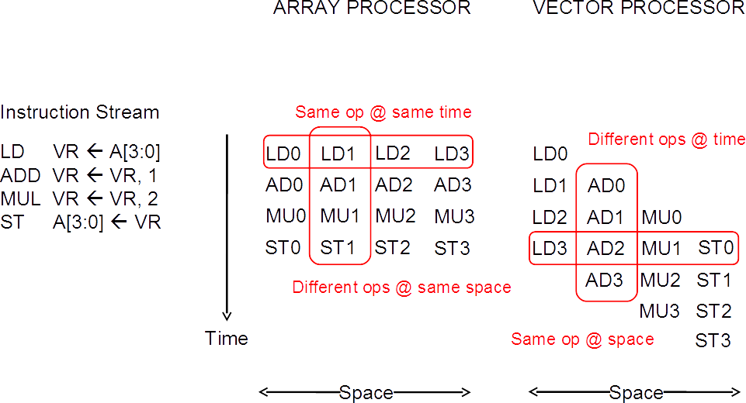
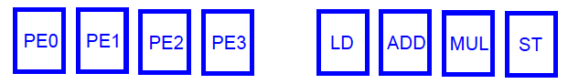
Array vs. Vector Processors
Array processor：又称为并行处理机、SIMD处理器。其核心是一个由多个处理单元构成的阵列，用单一的控制部件来控制多个处理单元对各自的数据进行相同的运算和操作。

Slide 5
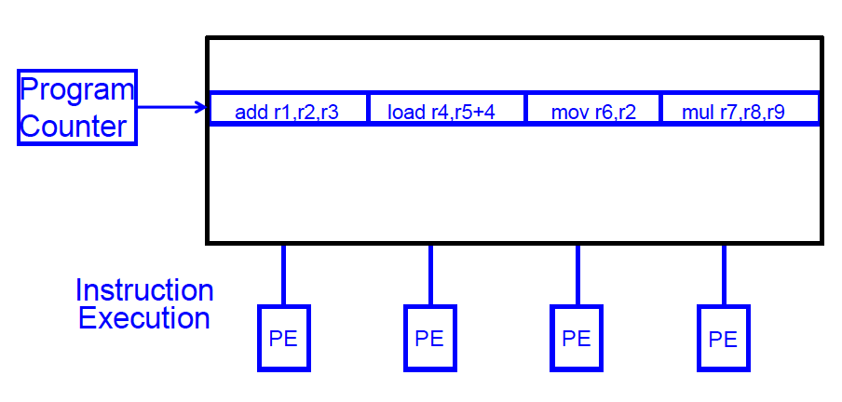
SIMD Array Processing vs. VLIW
VLIW: 多个独立的操作由编译器封装在一起

Slide 6
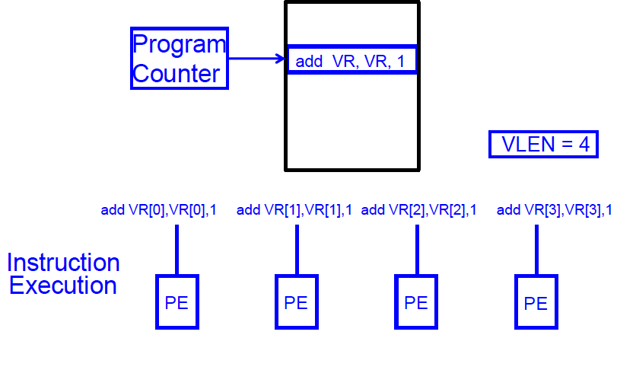
SIMD Array Processing vs. VLIW
Array processor: 单个操作作用在多个不同的数据元素上

Slide 7
Vector/SIMD Processing Summary
Vector/SIMD 机器适合挖掘数据级并行
同样的操作作用于不同的数据元素
向量内的元素操作独立，可有效提高性能，简化设计
性能的提升受限于代码的向量化
标量操作限制了向量机的性能
Amdahl’s Law
很多ISA包含SIMD操作指令
Intel MMX/SSEn/AVX, PowerPC AltiVec, ARM Advanced SIMD

Slide 8
GPU
GPU的起源
GPU基本的硬件结构
GPU编程模型
GPU的存储层次
GPU分支处理（发散与汇聚）

Slide 9
Graphics Processing Units (GPUs)
早期的GPU是指带有高性能浮点运算部件、可高效生成3D图形的具有固定功能的专用设备 (mid-late 1990s)
让PC机具有类似工作站的图形功能
用户可以配置图形处理流水线，但不是真正的对其编程
2001-2005，GPU加入了越来越多的可编程性
例如新的语言 Cg可用来编写一些小的程序处理图形的顶点或像素，是Windows DirectX的变体
大规模并行（针对每帧上百万顶点或像素）但非常受限于编程模型
有些用户注意到通过将输入和输出数据映射为图像，并对顶点或像素渲染计算 可进行通用计算
因为不得不使用图形流水线模型，这对完成通用计算来说是个非常难用的编程模型

Slide 10

What GPUs were originally designed to do: 3D rendering
Input: description of a scene:
3D surface geometry (e.g., triangle mesh)
surface materials, lights, camera, etc.
Output: image of the scene
Simple definition of rendering task: Generating a photorealistic image from 2D/3D models. Computing how each triangle in 3D mesh contributes to appearance of each pixel in the image?

Slide 11
Tip: how to explain a system
Step 1: describe the things (key entities) that are manipulated
The nouns

Slide 12
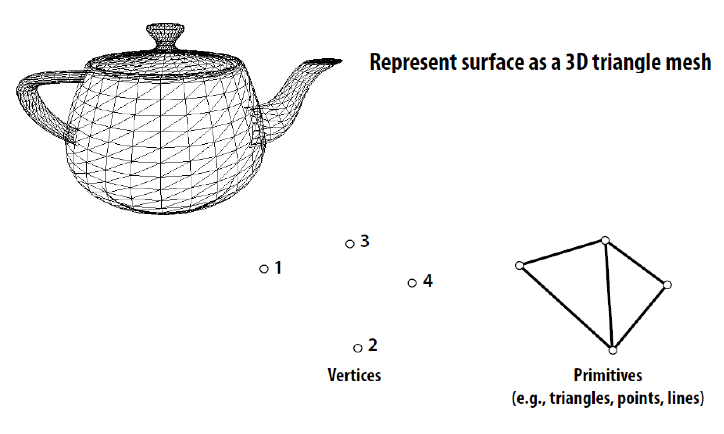
Real-time graphics primitives (entities)

Slide 13
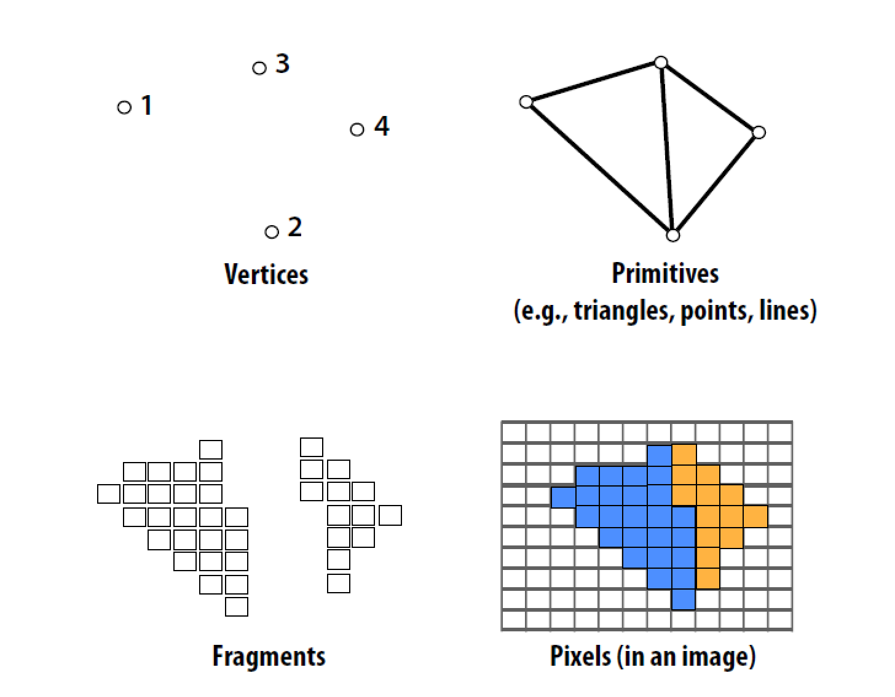
Real-time graphics primitives (entities)

Slide 14
Tip: how to explain a system
Step 1: describe the things (key entities) that are manipulated
The nouns
Step 2: describe operations the system performs on the entities
The verbs

Slide 15
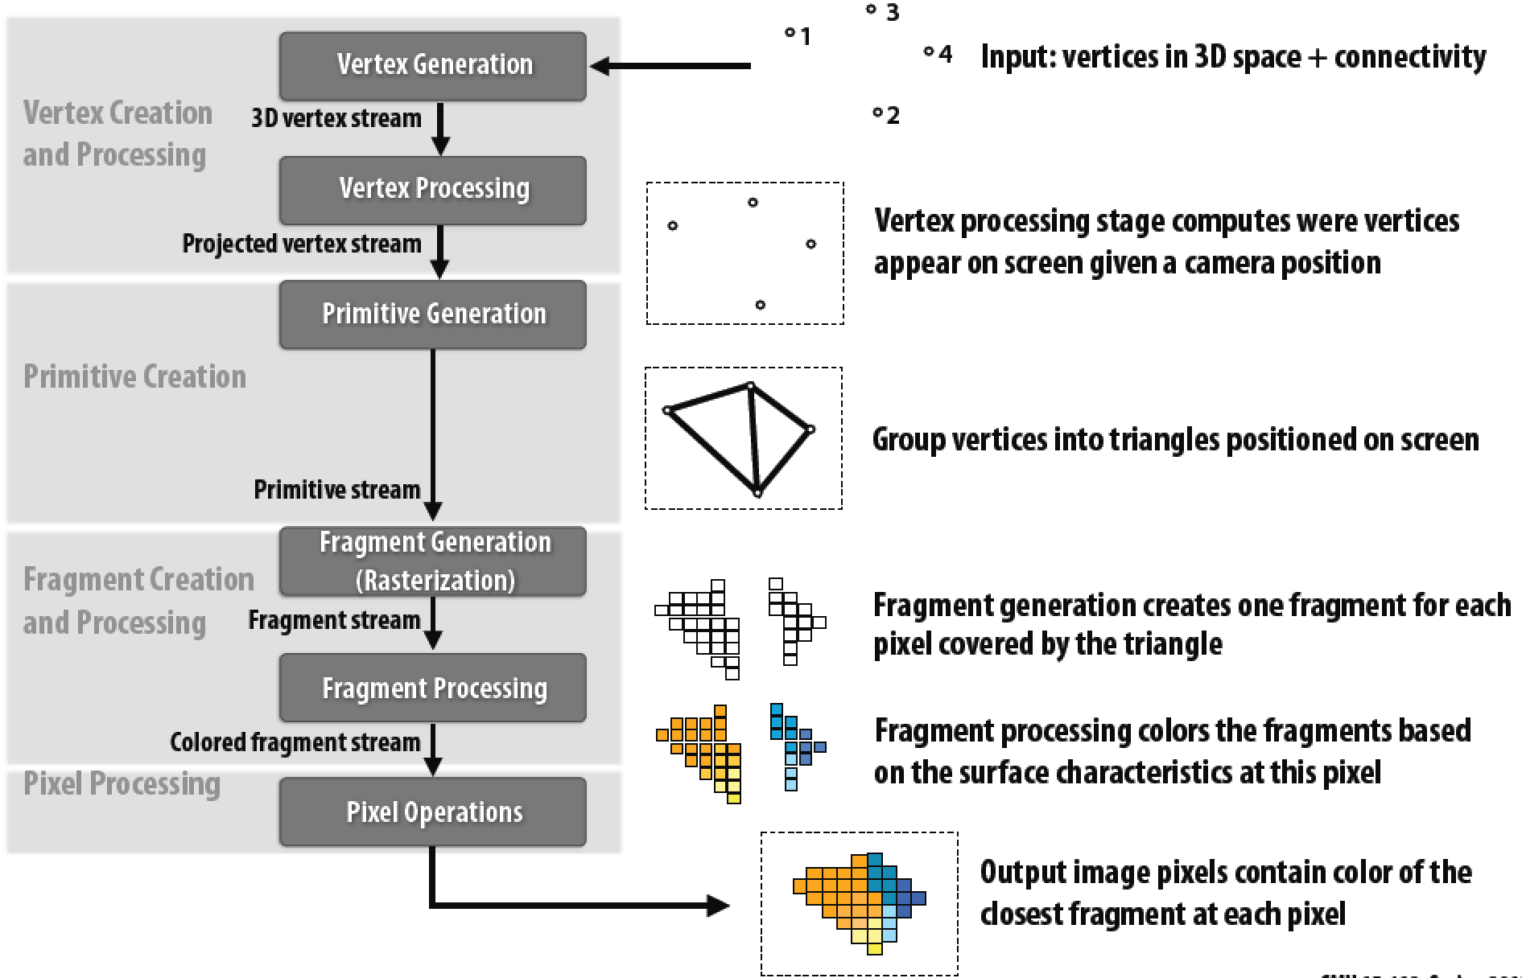
Graphics pipeline architecture
Performs operations on vertices, triangles, fragments, and pixels

Slide 16
Fragment processing simulates reflection of light off of real-world materials
Example materials:

Slide 17
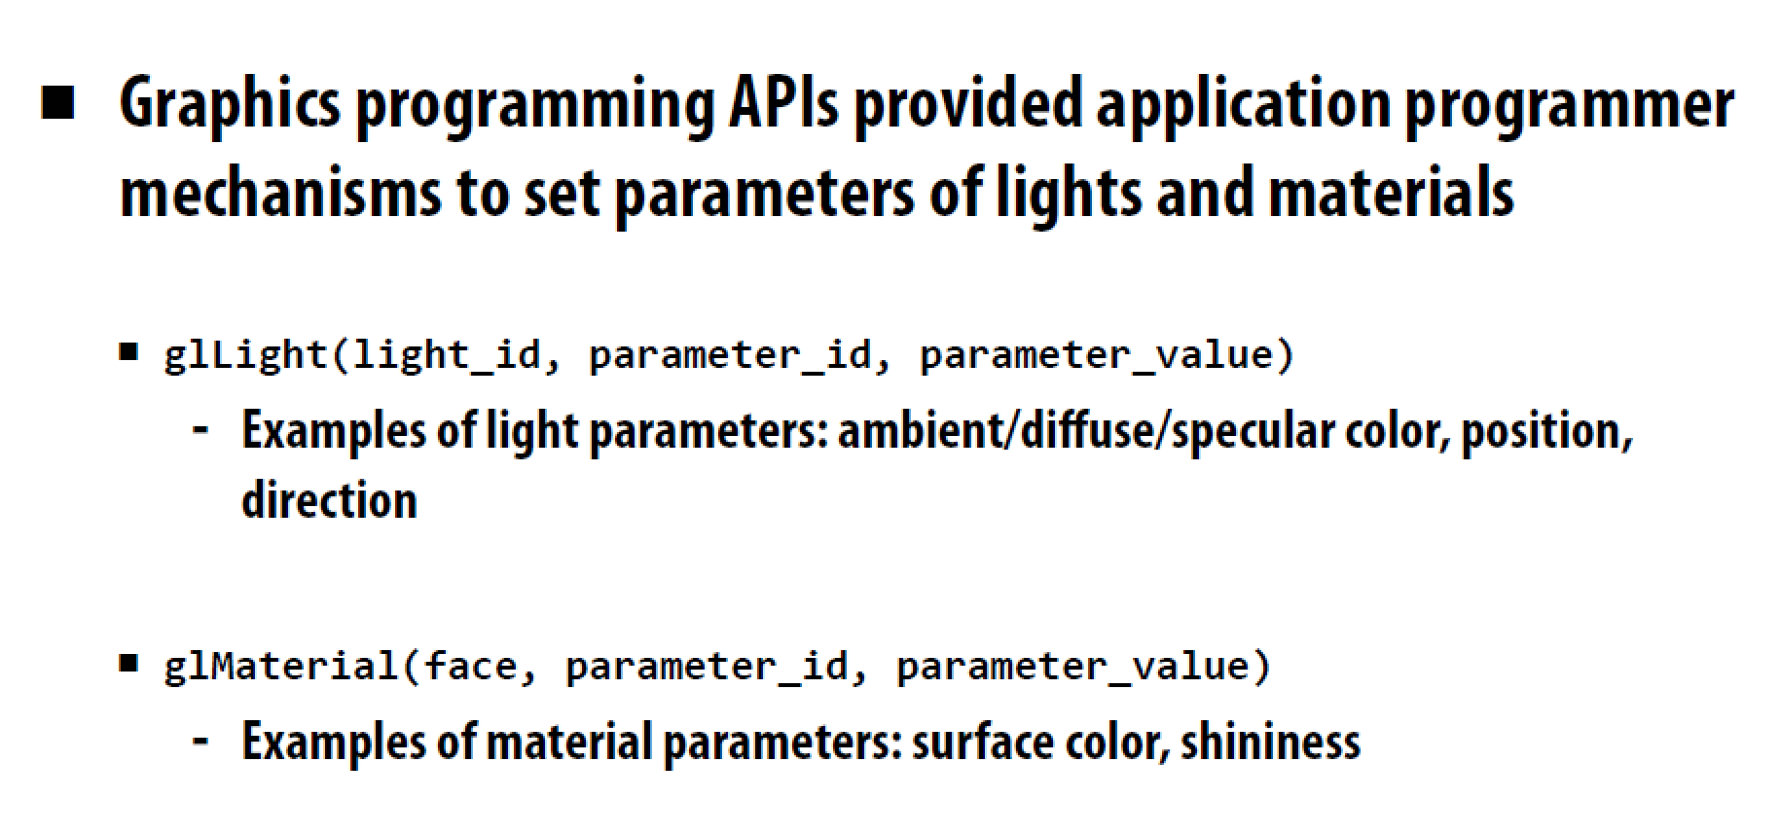
Early Graphics Programming

Slide 18
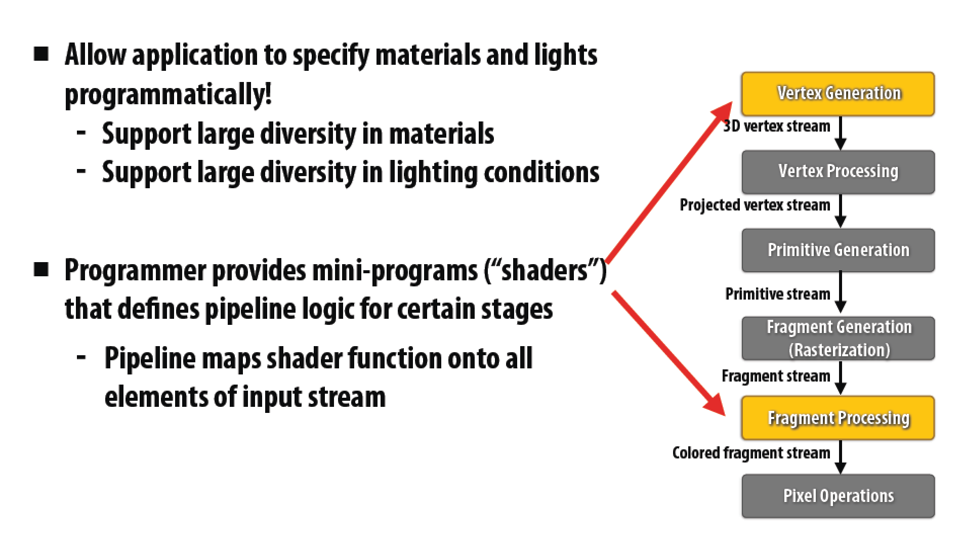
Graphics Shading Language

Slide 19
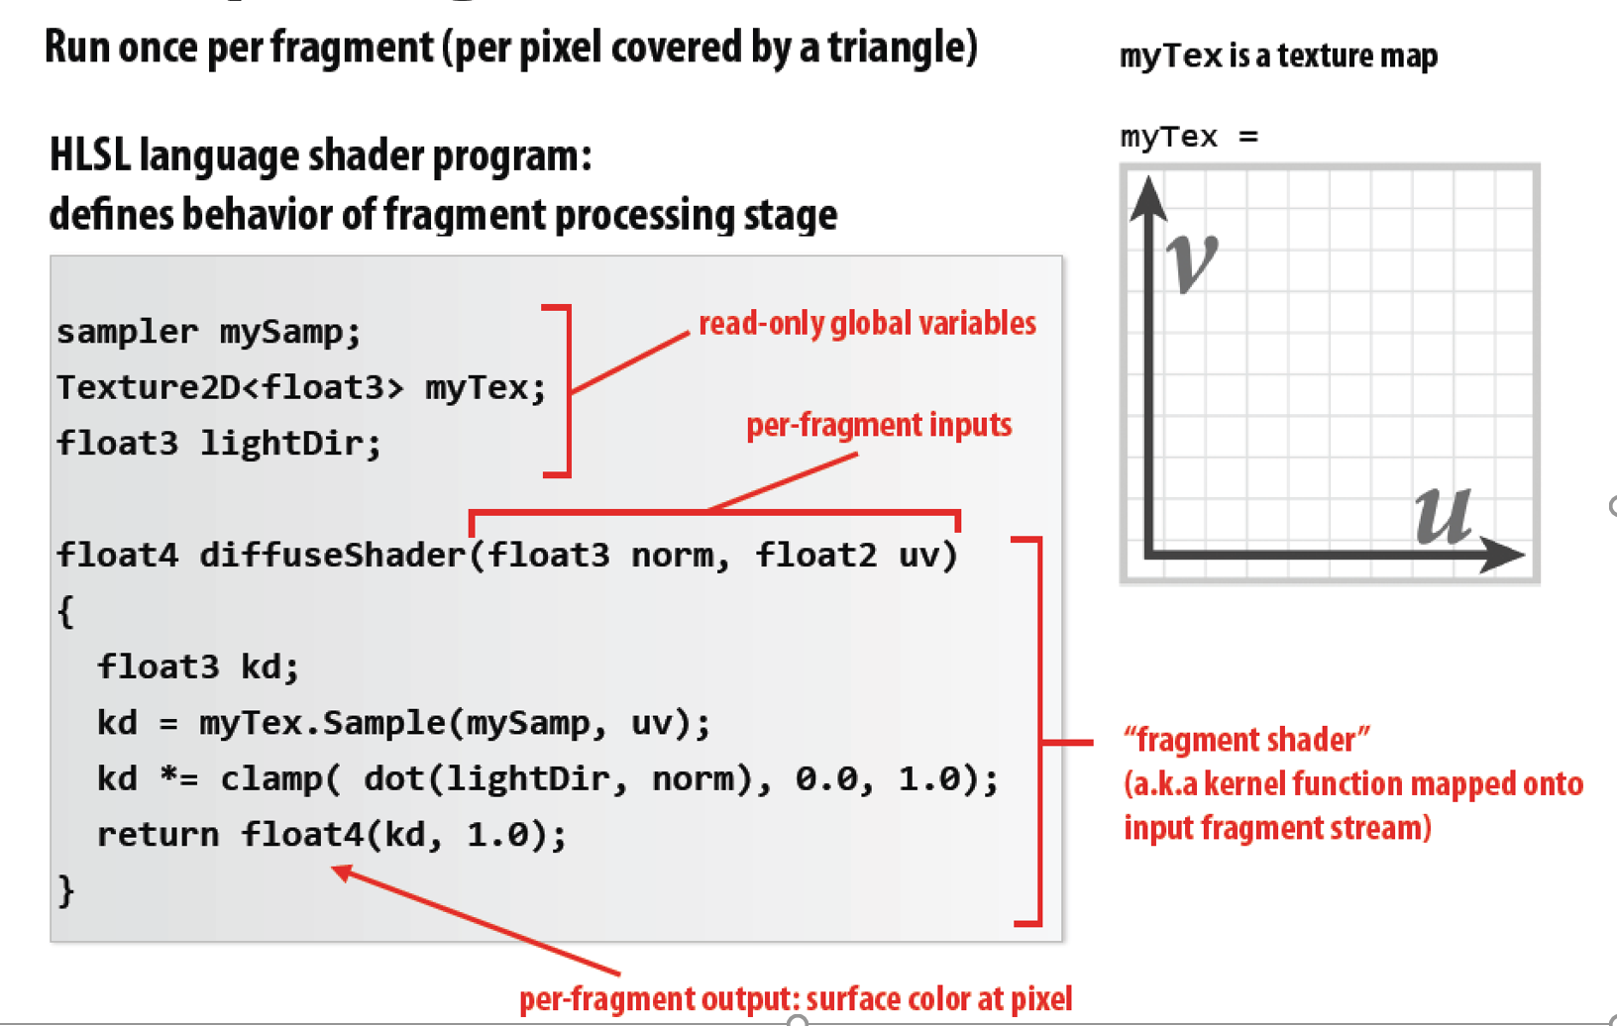
Example Fragment Shader

Slide 20

Shader Result
Image contains output of diffuseShader for each pixel covered by surface
(Pixels covered by multiple surfaces contain output from surface closest to camera)

Slide 21
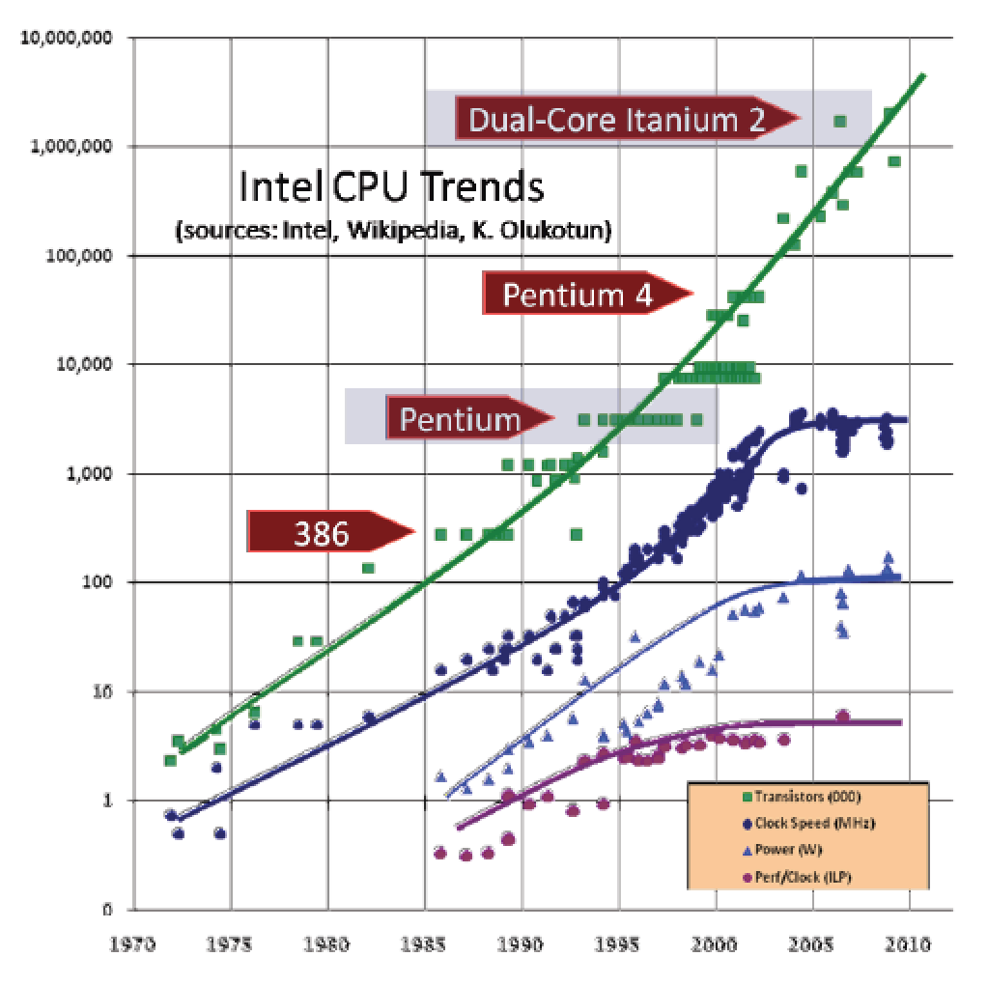
Observation circa 2001-2003
These GPUs are very fast processors for performing the same computation (shaders) on collections of data (streams of vertices, fragments, pixels).
Wait a minute! That sounds a lot like data parallelism to me! I remember data parallelism from exotic supercomputers in the 90s.

Slide 22
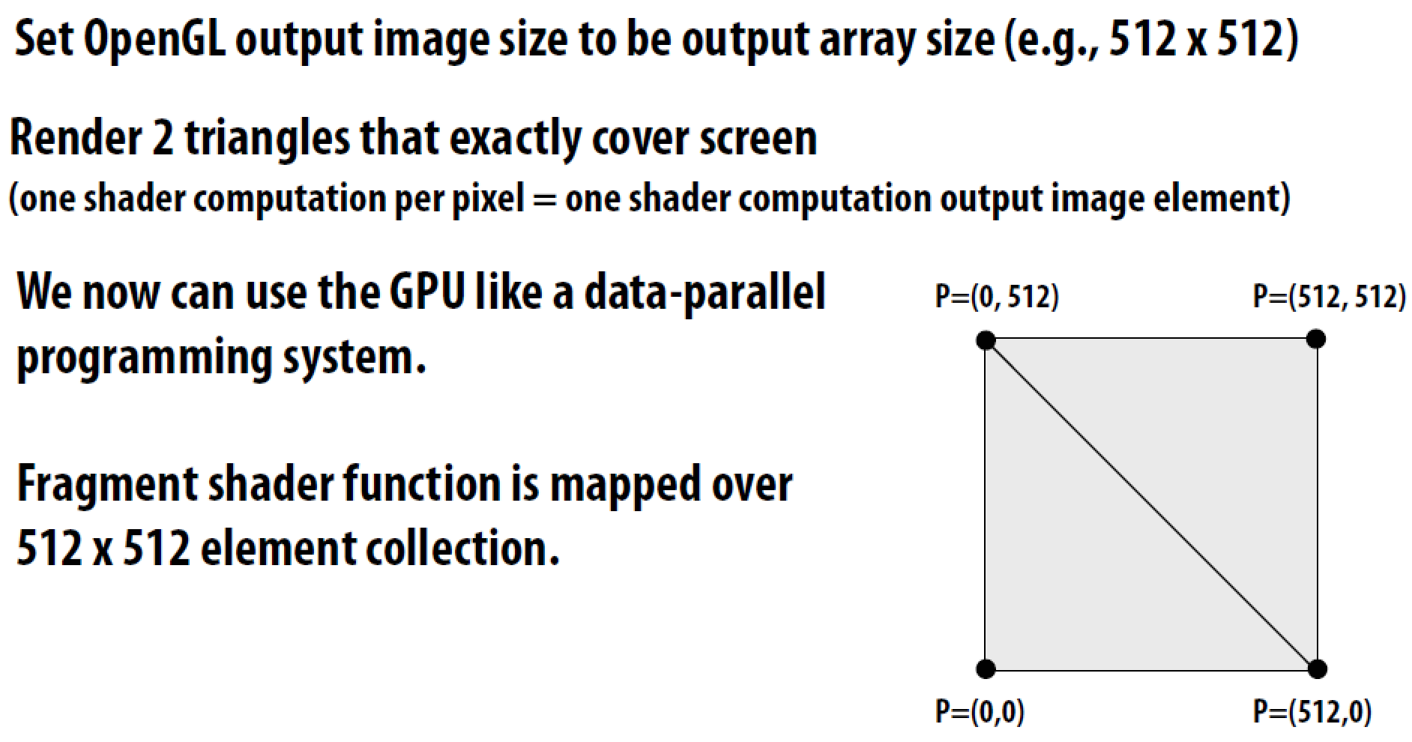
Observation circa 2001-2003

Slide 23
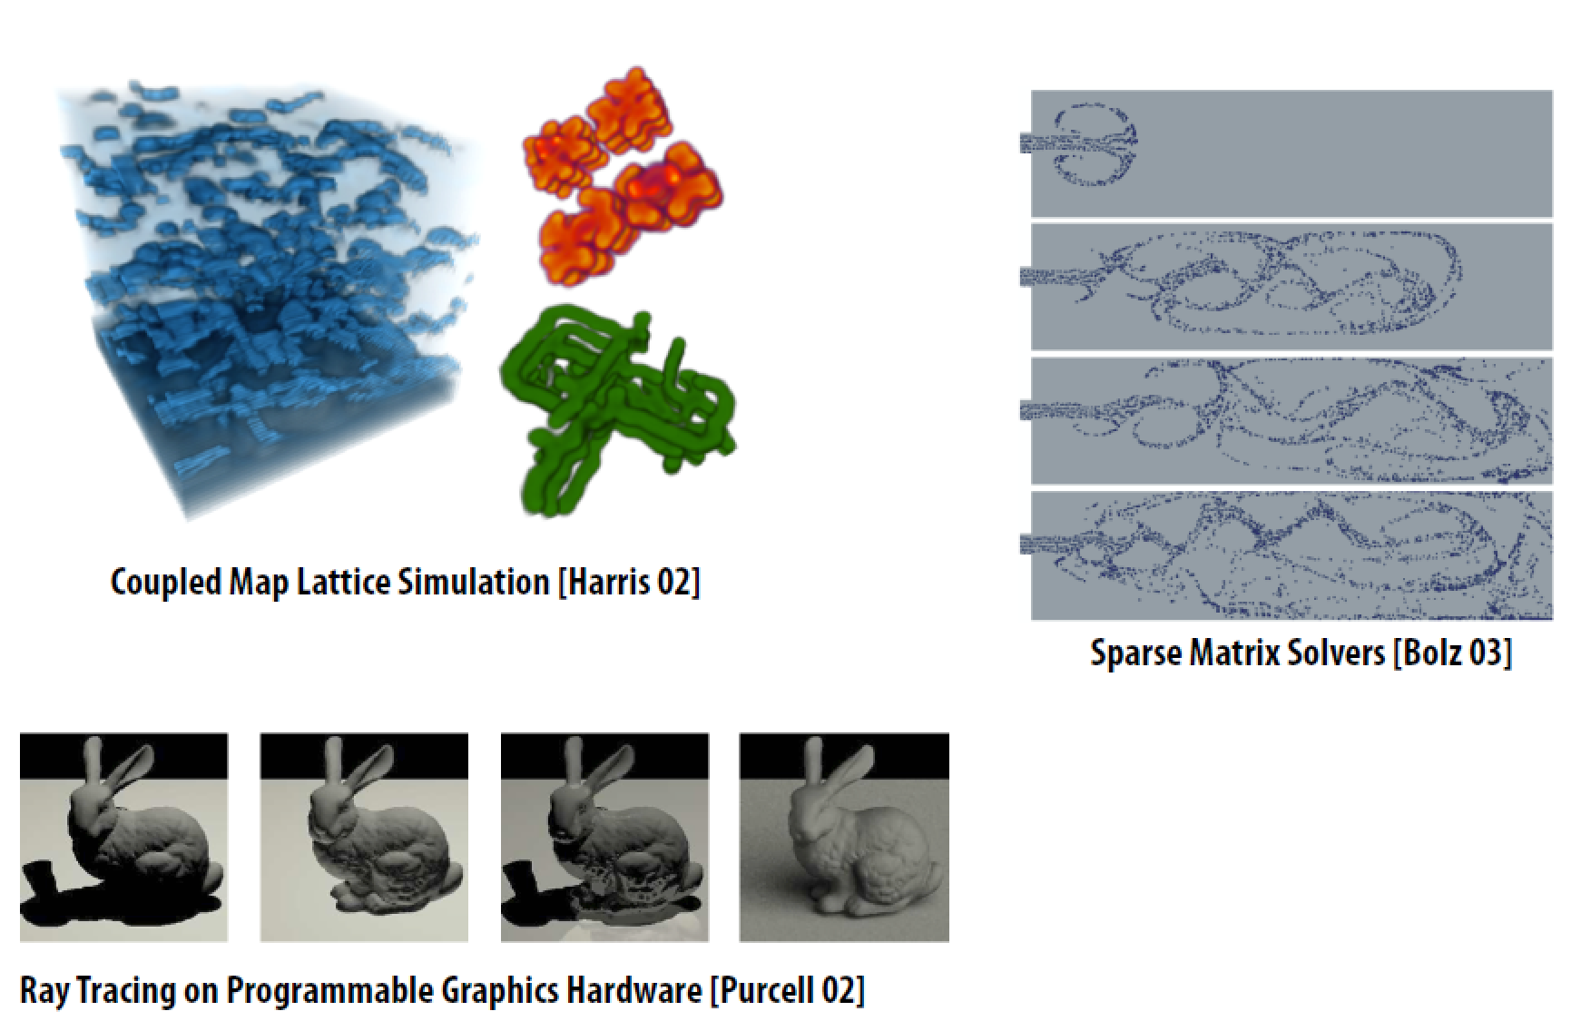
“GPGPU” 2002-2003

Slide 24
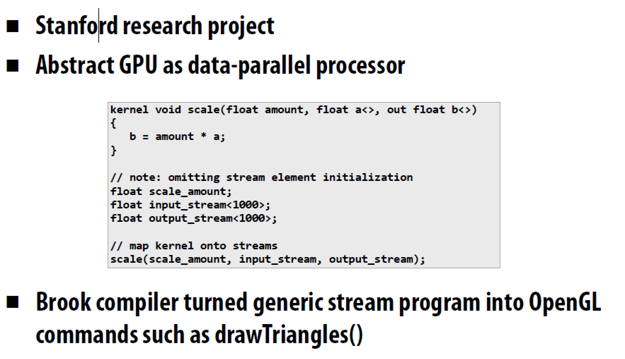
Brook stream programming language (2004)

Slide 25
General-Purpose GPUs (GP-GPUs)
2006年, Nvidia 的 GeForce 8800 GPU 支持一种新的编程语言: CUDA
“Compute Unified Device Architecture”
随后工业界推出OpenCL，与CUDA具有相同的ideas, 但独立于供应商
Idea: 针对通用计算，发挥GPU计算的高性能和存储器的高带宽来加速一些通用计算中的核心（Kernels）
一种协处理器模型（GPU作为附加设备）：Host CPU发射数据并行的kernels 到GP-GPU上运行
我们仅讨论Nvidia CUDA样式的简化版本，仅考虑GPU的计算核部分，不涉及图形加速部分

Slide 26
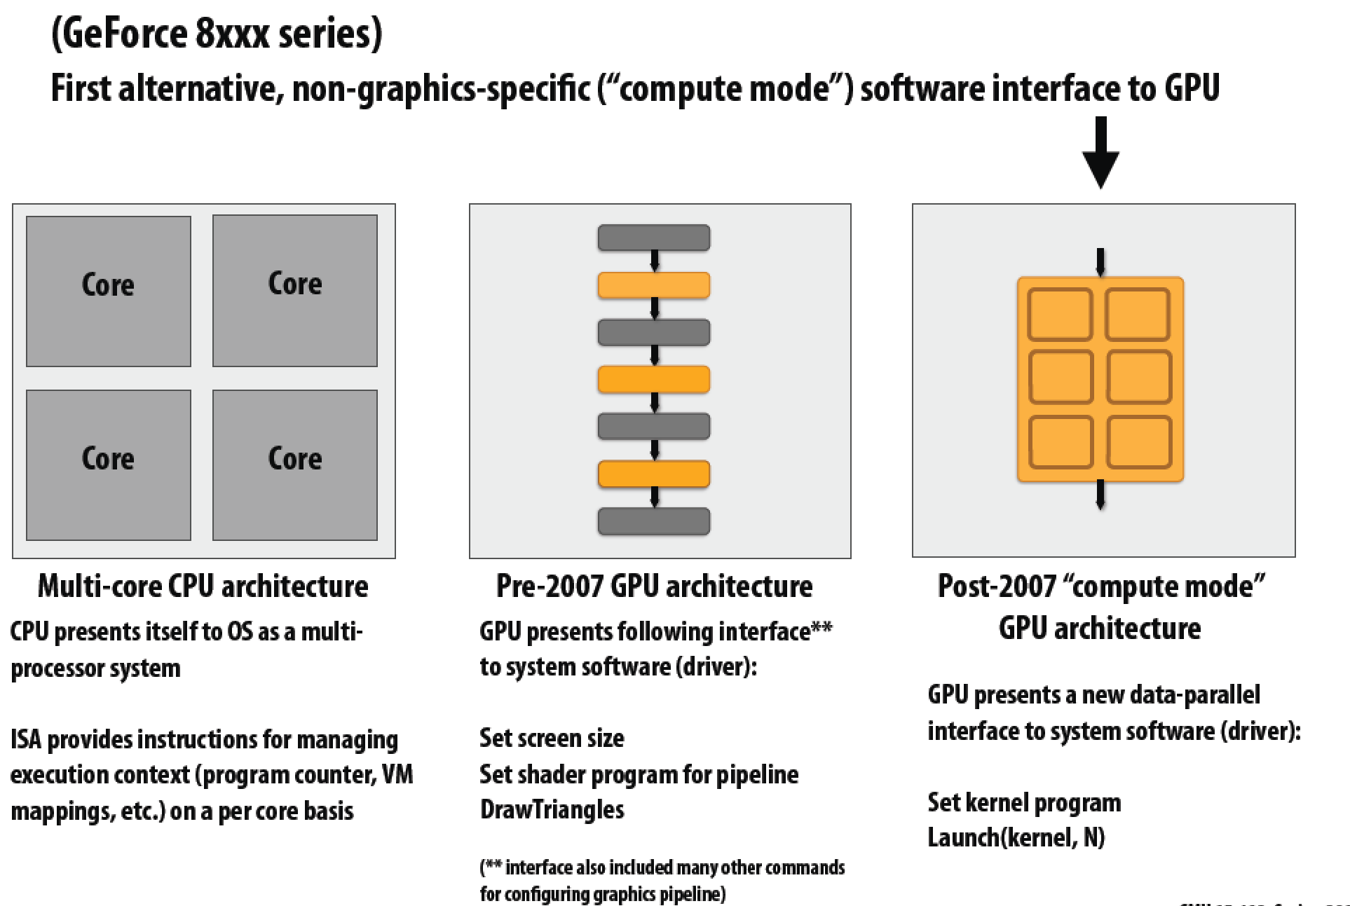
NVIDIA Tesla architecture (2007)

Slide 27
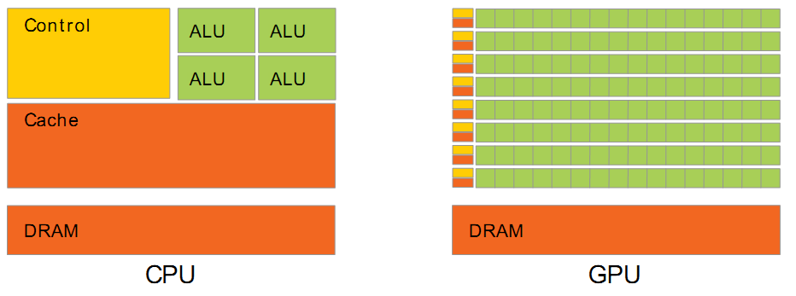
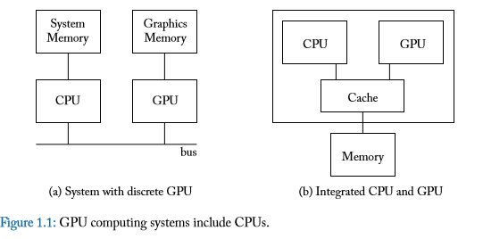
Using CPU+GPU Architecture
CPU+GPU异构多核系统
针对每个任务选择合适的处理器和存储器
通用CPU 适合执行一些串行的线程
串行执行快
带有cache，访问存储器延时低
GPU 适合执行大量并行线程
可扩放的并行执行
高带宽的并行存取
强控制、弱计算
弱控制、强计算
GPU
CPU
SMem
SMem
SMem
Cache
Cache
Host Memory
Bridge
Device Memory
PCIe

Slide 28
GPU: a multithreaded coprocessor
SM
SP: scalar processor
‘CUDA core’
Executes one thread
SP
SP
SP
SP
SP
SP
SP
SP
SP
SP
SP
SP
SP
SP
SP
SP
SM
streaming multiprocessor
32xSP (or 16, 48 or more)
Fast local ‘shared memory’
(shared between SPs)
16 KiB (or 64 KiB)
SHARED MEMORY
GLOBAL MEMORY
(ON DEVICE)

Slide 29
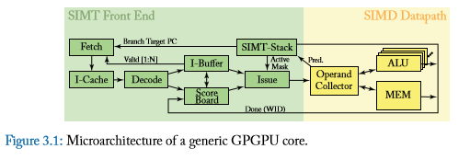
GPUs are SIMD Engines Underneath
指令流水线类似于SIMD的流水线。
不是用SIMD指令编程
基于一般的指令，应用由一组线程构成。
两个概念
Programming Model (Software) vs Execution Model (Hardware)
编程模型指程序员如何描述应用（从程序员角度看到的机器模型）
例如, 顺序模型 (von Neumann), 数据并行(SIMD), 数据流模型、多线程模型 (MIMD, SPMD), …
执行模型指硬件底层如何执行代码
例如, 乱序执行、向量机、数据流处理机、多处理机、多线程处理机等
执行模型与编程模型可以差别很大
例如., 顺序模型可以在乱序执行的处理器上执行。
SPMD 模型可以用SIMD处理器实现 (a GPU)

Slide 30
How Can You Exploit Parallelism Here?
for (i=0; i < N; i++)
C[i] = A[i] + B[i];
Scalar Sequential Code
load
Let’s examine three programming options to exploit instruction-level parallelism present in this sequential code:
1. Sequential (SISD)
2. Data-Parallel (SIMD)
3. Multithreaded (MIMD/SPMD)
Iter. 1
load
add
store
load
Iter. 2
load
add
store

Slide 31
Prog. Model 1: Sequential (SISD)
Scalar Sequential Code
Can be executed on a Pipelined processor
Out-of-order execution processor
Independent instructions executed when ready
Different iterations are present in the instruction window and can execute in parallel in multiple functional units
In other words, the loop is dynamically unrolled by the hardware
Superscalar or VLIW processor
Can fetch and execute multiple instructions per cycle
load
Iter. 1
load
add
store
load
Iter. 2
load
add
store
for (i=0; i < N; i++)
C[i] = A[i] + B[i];

Slide 32
Prog. Model 2: Data Parallel (SIMD)
Scalar Sequential Code
Vector Instruction
Vectorized Code
load
load
VLD A → V1
load
load
Iter. 1
load
load
VLD B → V2
add
VADD V1 + V2 → V3
add
add
store
store
store
VST V3 → C
load
Iter. 1
Iter. 2
Realization: Each iteration is independent
Idea: Programmer or compiler generates a SIMD instruction to execute the same instruction from all iterations across different data
Best executed by a SIMD processor (vector, array)
Iter. 2
load
add
store
for (i=0; i < N; i++)
C[i] = A[i] + B[i];

Slide 33
Prog. Model 3: Multithreaded
Scalar Sequential Code
load
load
for (i=0; i < N; i++)
C[i] = A[i] + B[i];
load
load
Iter. 1
load
load
add
add
add
store
store
store
load
Iter. 1
Iter. 2
load
Realization: Each iteration is independent
Idea: Programmer or compiler generates a thread to execute each iteration. Each thread does the same thing (but on different data)
Can be executed on a MIMD machine
Iter. 2
add
store

Slide 34
Prog. Model 3: Multithreaded
for (i=0; i < N; i++)
C[i] = A[i] + B[i];
load
load
load
load
add
add
store
store
Iter. 1
Iter. 2
Realization: Each iteration is independent
Idea: Programmer or compiler generates a thread to execute each iteration. Each thread does the same thing (but on different data)
Can be executed on a MIMD machine
This particular model is also called:
SPMD: Single Program Multiple Data
Can be executed on a SIMT machine
Single Instruction Multiple Thread
Can be executed on a SIMD machine

Slide 35
SPMD
Single procedure/program, multiple data
它是一种编程模型而不是计算机组织
每个处理单元执行同样的过程，处理不同的数据
这些过程可以在程序中的某个点上同步，例如 barriers
多条指令流执行相同的程序
每个程序/过程
操作不同的数据
运行时可以执行不同的控制流路径
许多科学计算应用以这种方式编程，运行在MIMD硬件结构上 (multiprocessors)
现代 GPUs 以这种类似的方式编程，运行在SIMD硬件上

Slide 36
A GPU is a SIMD (SIMT) Machine
GPU不是用SIMD指令编程
使用线程 (SPMD 编程模型)
每个线程执行同样的代码，但操作不同的数据元素
每个线程有自己的上下文(即可以独立地启动/执行等）
一组执行相同指令的线程由硬件动态组织成warp
一个warp是由硬件形成的SIMD操作

Slide 37
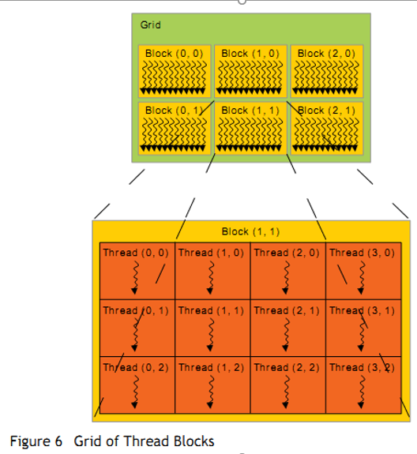
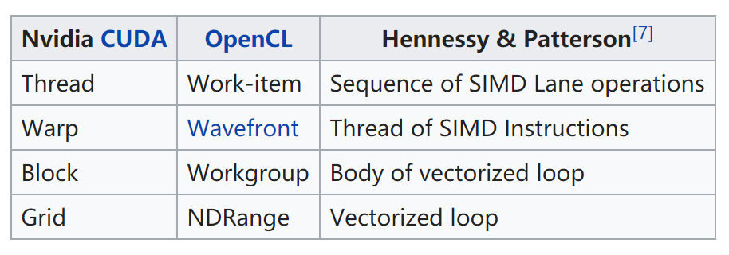
Threads and Blocks
一个线程对应一个数据元素
大量的线程组织成很多线程块
许多线程块组成一个网格
GPU 由硬件对线程进行管理
Thread Block Scheduler
SIMD Thread Scheduler

Slide 38
Programmer’s View of Execution
blockIdx 0
threadId 0
blockDim = 256 (programmer can choose)
threadId 1
创建足够的线程块以适应输入向量
(Nvidia 中将由多个线程块构成的、在GPU上运行的代码 称为Grid，Grid可以是2维的)
threadId 255
blockIdx 1
threadId 0
threadId 1
threadId 255
blockIdx
(n+255)/256)
threadId 0
Conditional (i<n) turns off unused threads in last block
threadId 1
threadId 255

Slide 39
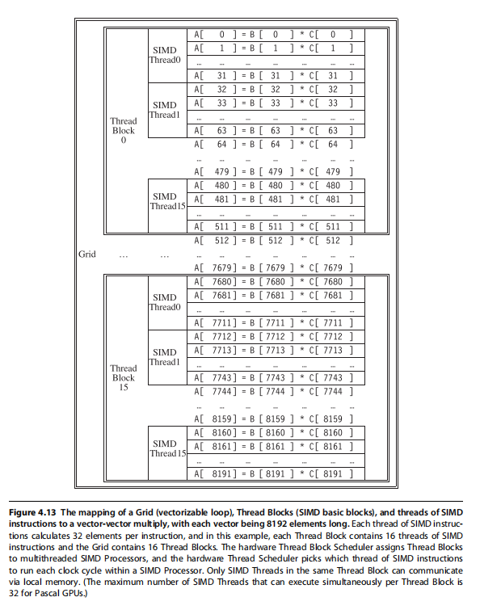
处理向量长度为8192的程序组织：
Grid 包含16个线程块（512个元素/Block）
Block包含16个SIMD 线程
每个SIMD线城处理32个向量元素

Slide 40
Hardware Execution Model
GPU
CPU
Core 0
Core 1
Core 15
Lane 0
Lane 0
Lane 0
Lane 1
Lane 1
Lane 1
Lane 15
Lane 15
Lane 15
CPU Memory
GPU Memory
GPU 由多个并行核构成，每个核是一个多线程SIMD处理器（包含多个车道（Lanes）)
CPU 发送整个 “grid”到GPU，由GPU将这些线程块分发到多个核上（每个线程块在一个核上运行）
GPU上核的数量对程序员而言是透明的

Slide 41
Simplified CUDA Programming Model
计算由大量的相互独立的线程(CUDA threads or microthreads) 完成，这些线程组合成线程块（thread blocks）
// C version of DAXPY loop.
void daxpy(int n, double a, double*x, double*y)
{ for (int i=0; i<n; i++)
y[i] = a*x[i] + y[i]; }
// CUDA version.
__host__ // Piece run on host processor.
int nblocks = (n+255)/256; // 256 CUDA threads/block
daxpy<<<nblocks,256>>>(n,2.0,x,y);
__device__ // Piece run on GP-GPU.
void daxpy(int n, double a, double*x, double*y)
{ int i = blockIdx.x*blockDim.x + threadId.x;
if (i<n) y[i]=a*x[i]+y[i]; }

Slide 42
NVIDIA Instruction Set Arch.
ISA 是硬件指令集的抽象
“Parallel Thread Execution (PTX)”
使用虚拟寄存器
用软件将其翻译成机器码
Example:
shl.s32 R8, blockIdx, 9 ; Thread Block ID * Block size (512 or 2⁹)
add.s32 R8, R8, threadIdx ; R8 = i = my CUDA thread ID
ld.global.f64 RD0, [X+R8] ; RD0 = X[i]
ld.global.f64 RD2, [Y+R8] ; RD2 = Y[i]
mul.f64 RD0, RD0, RD4 ; Product in RD0 = RD0 * RD4 (scalar a)
add.f64 RD0, RD0, RD2 ; Sum in RD0 = RD0 + RD2 (Y[i])
st.global.f64 [Y+R8], RD0 ; Y[i] = sum (X[i]*a + Y[i])

Slide 43
CUDA kernel maps to Grid of Blocks
kernel_func<<<nblk, nthread>>>(param, … );
Host Thread
Grid of Thread Blocks
. . .
GPU
SMs:
CPU
SMem
SMem
SMem
Cache
Cache
Host Memory
Bridge
Device Memory
PCIe

Slide 44

Thread blocks execute on a SM Thread instructions execute on a SP
float myVar;
__shared__ float shVar;
__device__ float glVar;
Thread
Block
Registers
Per-block Shared
Memory
Per-app
Device Global
Memory
Per-thread
Local Memory
GPU
SMs:
CPU
SMem
SMem
SMem
Cache
Cache
Host Memory
Bridge
Device Memory
PCIe
Notes:
SM: Streaming Multiprocessor
PTX: Parallel Thread Execution

Slide 45
CUDA：“Single Instruction, Multiple Thread”
GPUs 使用 SIMT模型, 每个CUDA线程的标量指令流汇聚在一起在硬件上以SIMD方式执行 (Nvidia groups 32 CUDA threads into a warp)
µT0
µT1
µT2
µT3
µT4
µT5
µT6
µT7
ld x
Scalar instruction stream
mul a
ld y
add
st y
SIMD execution across warp

Slide 46
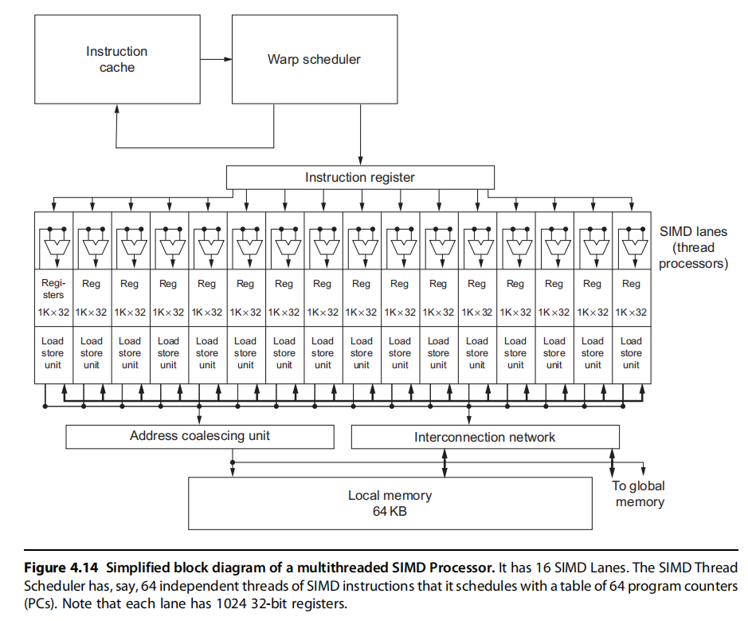

Slide 47
SPMD on SIMT Machine
load
load
Warp 0 at PC X
load
load
Warp 0 at PC X+1
add
add
Warp 0 at PC X+2
store
store
Warp 0 at PC X+3
Iter. 1
Iter. 2
Warp: A set of threads that execute
the same instruction (i.e., at the same PC)
Realization: Each iteration is independent
Idea: Programmer or compiler generates a thread to execute each iteration. Each thread does the same thing (but on different data)
Can be executed on a MIMD machine
for (i=0; i < N; i++)
C[i] = A[i] + B[i];
This particular model is also called:
SPMD: Single Program Multiple Data
A GPU executes it using the SIMT model:
Single Instruction Multiple Thread
Can be executed on a SIMD machine

Slide 48
SIMD vs. SIMT Execution Model
SIMD: 一条指令流（一串顺序的SIMD指令），每条指令对应多个数据输入（向量指令）
SIMT: 多个指令流（标量指令）构成线程， 这些线程动态构成warp。一个Warp处理多个数据元素
SIMT 主要优点：
可以独立地处理线程,即每个线程可以在任何标量流水线上单独执行（ MIMD 处理模式）
可以将线程组织成warp，即可以将执行相同指令流的线程构成warp，形成SIMD 处理模式, 以充分发挥SIMD处理的优势

Slide 49
Multithreading of Warps
设一个warp由 32 threads构成
如果有32K次循环 → 1K 个warps
这些Warps可以在同一条流水线上交替执行
Fine grained multithreading of warps
for (i=0; i < N; i++)
C[i] = A[i] + B[i];
load
load
Warp 0 at PC X
Warp 1 at PC X
load
load
add
add
Warp 20 at PC X+2
store
store
Iter. 1
Iter. 2
Iter. 32+1
Iter. 32+2
Iter. 20*32 + 1
Iter. 20*32 + 2

Slide 50
Warps and Warp-Level FGMT
Warp: 执行相同指令（操作不同的数据元素）的一组线程
同一Warp中的所有线程执行相同代码
Warp: The threads that run lengthwise in a woven fabric …
Thread Warp 3
Thread Warp 8
Thread Warp
Common PC
Scalar
Scalar
Scalar
Scalar
Thread Warp 7
Thread
Thread
Thread
Thread
W
X
Y
Z
SIMD Pipeline
Notes:
In SIMD, you need to specify the data array + an instruction (on which to operate the data on) + THE INSTRUCTION WIDTH. Eg: You might want to add 2 integer arrays of length 16, then a SIMD instruction would look like (the instruction has been cooked-up by me for demo) add.16 arr1 arr2 However, SIMT doesn't bother about the instruction width. So, essentially, you could write the above example as: arr1[i] + arr2[i] and then launch as many threads as the length of the array, as you want. Note that, if the array size was, let us say, 32, then SIMD EXPECTS you to explicitly call two such 'add.16' instructions! Whereas, this is not the case with SIMT.

Slide 51
Warp Instruction Level Parallelism
Can overlap execution of multiple instructions
Example machine has 32 threads per warp and 8 lanes
Completes 24 operations/cycle while issuing 1 warp/cycle
Load Unit
Multiply Unit
Add Unit
W0
W1
W2
time
W3
W4
W5
Warp issue
Slide credit: Krste Asanovic

Slide 52
Latency Hiding via Warp-Level FGMT
Warp: 一组执行相同指令的线程（作用于不同的数据元素）
Fine-grained multithreading
流水线上每次执行每个线程的一条指令 (No interlocking)
通过warp的交叉执行来隐藏延时
所有线程的寄存器值保存在寄存器文件中
FGMT 可以容忍长延时
Millions of pixels
Thread Warp 3
Warps available
Thread Warp 8
for scheduling
Thread Warp 7
SIMD Pipeline
I-Fetch
Decode
R
R
R
F
F
F
Warps accessing
A
A
A
memory hierarchy
L
L
L
U
U
U
Miss?
D-Cache
Thread Warp 1
All Hit?
Data
Thread Warp 2
Writeback
Thread Warp 6
Slide credit: Tor Aamodt
Notes:
With a large number of shader threads multiplexed on the same execution re- sources, our architecture employs fine-grained multithreading where individual threads are interleaved by the fetch unit to proactively hide the potential latency of stalls before they occur. As illustrated by Figure, warps are issued fairly in a round-robin queue. When a thread is blocked by a memory request, shader core simply removes that thread’s warp from the pool of “ready” warps and thereby allows other threads to proceed while the memory system processes its request.
With a large number of threads (1024 per shader core) interleaved on the same pipeline, FGMT effectively hides the latency of most memory operations since the pipeline is occupied with instructions from other threads while memory operations complete. also hides the pipeline latency so that data bypassing logic can potentially be omitted to save area with minimal impact on performance. simplify the dependency check logic design by restricting each thread to have at most one instruction running in the pipeline at any time.

Slide 53
Warp-based SIMD vs. Traditional SIMD
传统的SIMD仅包含一个线程
Lock step: 一条向量指令执行完，然后启动下一条向量指令
编程模型为SIMD (no extra threads) → SW 需要知道向量长度
ISA 包含vector/SIMD指令
Warp-based SIMD 由多个标量线程构成，以SIMD方式执行 (即所有的线程执行相同的指令)
不需要lock step
每个线程可以单独对待(即可以映射到不同的warp中），编程模型不是SIMD
SW 不必知道向量长度
多个线程可以动态构成warp
ISA是标量ISA → 可以动态形成逻辑上的向量指令
是一种在SIMD硬件上实现的SPMD编程模型

Slide 54
Warp Execution (Recall the Slide)
32-thread warp executing ADD A[tid],B[tid] → C[tid]
Execution using one pipelined functional unit
Execution using four pipelined functional units
A[6]
B[6]
A[24]
B[24]
A[25]
B[25]
A[26]
B[26]
A[27]
B[27]
A[5]
B[5]
A[20]
B[20]
A[21]
B[21]
A[22]
B[22]
A[23]
B[23]
A[4]
B[4]
A[16]
B[16]
A[17]
B[17]
A[18]
B[18]
A[19]
B[19]
A[3]
B[3]
A[12]
B[12]
A[13]
B[13]
A[14]
B[14]
A[15]
B[15]
C[2]
C[8]
C[9]
C[10]
C[11]
C[1]
C[4]
C[5]
C[6]
C[7]
C[0]
C[0]
C[1]
C[2]
C[3]
Slide credit: Krste Asanovic

Slide 55
SIMD Execution Unit Structure
Functional Unit
Registers
for each
Thread
Registers for thread IDs
0, 4, 8, …
Registers for thread IDs
1, 5, 9, …
Registers for thread IDs
2, 6, 10, …
Registers for thread IDs
3, 7, 11, …
Lane
Memory Subsystem
Slide credit: Krste Asanovic

Slide 56
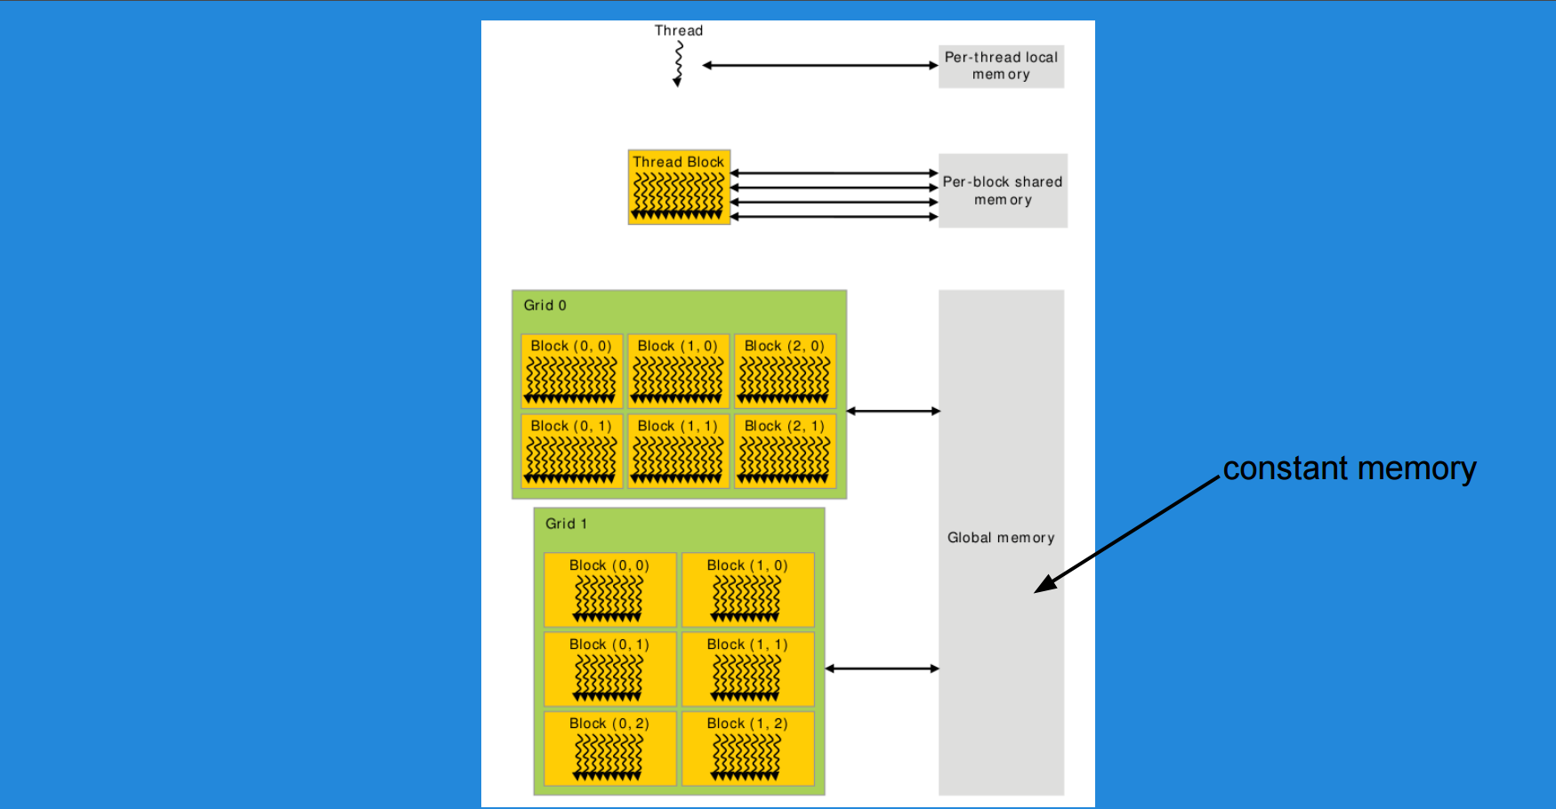
GPU Memory Hierarchy

Slide 57
GPU Global Memory
Global memory is the “main” memory of the GPU. It has global scope and lifetime of the allocating program (or until cudaFree is called).
Global memory is similar to the heap in a C program.
Global memory is separate hardware from the GPU core (containing SM’s,
caches, etc). The vast majority of memory on GPU is global memory. If data doesn’t fit into global memory, you are going to process it in chunks that do fit in globalmemory.
GPUs have .5 - 24GB of global memory, with most now having ~2GB. Global memory latency is ~300ns on Kepler and ~600ns on Fermi

Slide 58
GPU Shared Memory
Very fast memory located in the SM
Same hardware as L1 cache, ~5ns of latency
Maximum size of 48KB, but user configurable
Scope of shared memory is the block

Slide 59
Registers
Fastest “memory” possible, about 10x faster than shared
Memory
Most stack variables declared in kernels are stored in registers (example: float x)
Statically indexed arrays stored on the stack are sometimes put in registers

Slide 60
Local Memory
Local memory is everything on the stack that can’t fit in registers. The scope of local memory is just the thread.
Local memory is stored in global memory (much slower than registers!)

Slide 61
GPU L1 Cache
Fermi - caches local & global memory (local memory’s scope is local to the thread and it resides off-chip)
Kepler, Maxwell - only caches local memory
same hardware as shared memory
configurable size (16, 32, 48KB)
each SM has its own L1 cache

Slide 62
GPU L2 Cache
caches all global & local memory accesses
~1MB in size
shared by all SM’s

Slide 63
Constant Memory
Used for constants that cannot be compiled into program
Constants must be set from host before running kernel
Constant memory is global memory with a special cache
64KB for user, 64KB for compiler (kernel arguments are
passed through constant memory)

Slide 64
Constant Cache
8KB cache on each SM specially designed to broadcast a single memory address to all threads in a warp (called static indexing)
Can also load any statically indexed data
through constant cache using “load uniform” (LDU) instruction

Slide 65
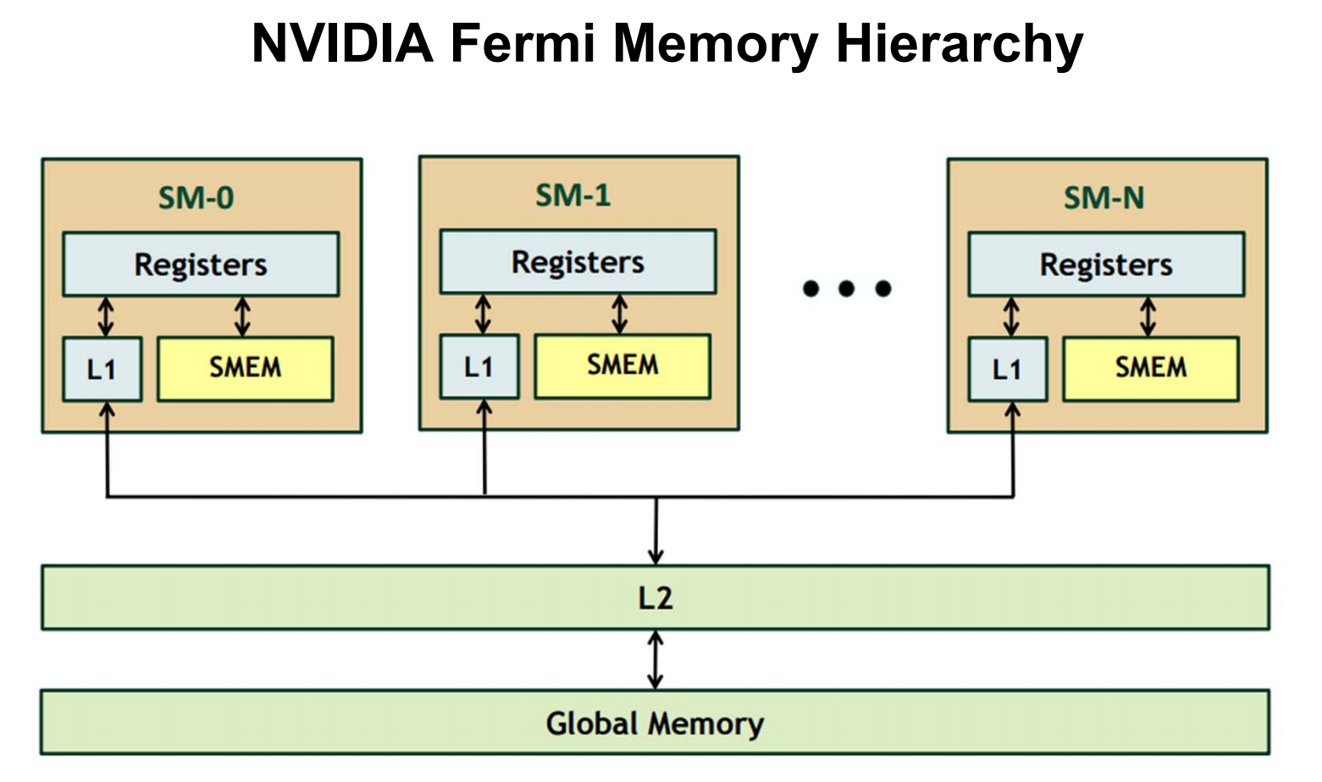
GPU Memory Hierarchy

Slide 66
SIMT Memory Access
不同线程的相同指令使用线程id来存取不同的数据元素
Let’s assume N=16, 4 threads per warp → 4 warps
0
1
2
3
4
5
6
7
8
9
10
11
12
13
14
15
Threads
+
0
1
2
3
4
5
6
7
8
9
10
11
12
13
14
15
Data elements
+
+
+
+
Warp 0
Warp 1
Warp 2
Warp 3
Slide credit: Hyesoon Kim

Slide 67
Global Memory Access
Each thread issues memory accesses to data types of varying sizes, perhaps as small as 1 byte entities
Given an address to load or store, memory returns/updates “segments” of either 32 bytes, 64 bytes or 128 bytes
Maximizing bandwidth:
Operate on an entire 128 byte segment for each memory transfer

Slide 68
Understanding Global Memory Access
Start with memory request by smallest numbered thread.
Find the memory segment that contains the address (32, 64 or 128 byte segment, depending on data type)
Find other active threads requesting addresses within that segment and coalesce
Reduce transaction size if possible
Access memory and mark threads as “inactive”
Repeat until all threads in half-warp are serviced
(Includes Tesla and GTX platforms)

Slide 69
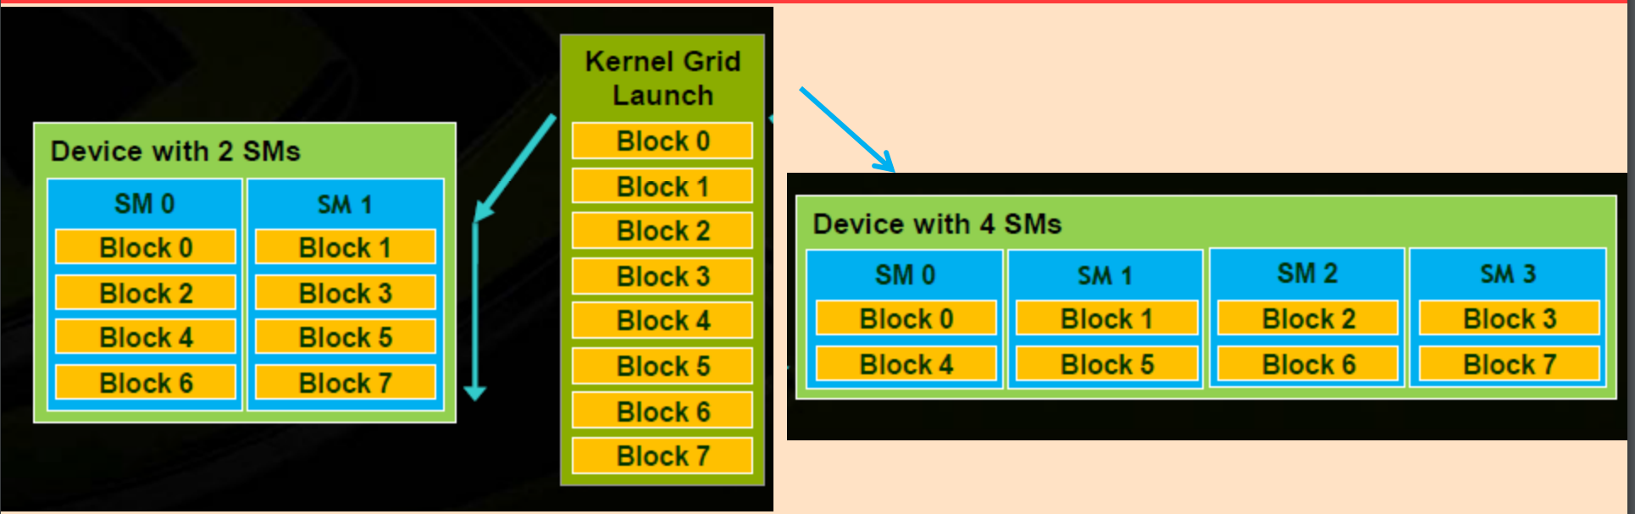
Thread Block Scheduling
• Each TB allocated to an SM; Multiple TBs in a SM
• Threads in a thread block may need to cooperate
– Load/Store from memory together
– Share results (through shared memory)
– Synchronize with each other
• Thread Blocks can execute in any order

Slide 70
Resident Thread Blocks
• No. of thread blocks allocated to SM is limited by
– Maximum Thread blocks
– Maximum number of threads
– Registers (Registers per thread * Threads per Block * # Blks)
– Shared Memory (Shared Memory per Block * # Blks)
• Warps of resident threadblocks are context switched to hide (long) latency

Slide 71
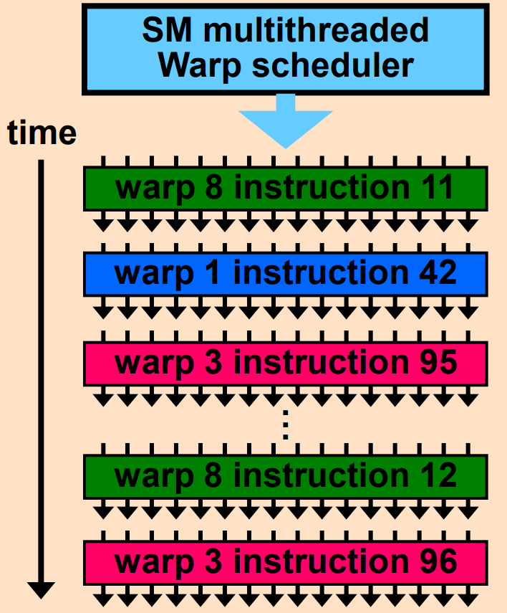
SM Warp Scheduling
• Each SM launches Warps of
Threads
– 2 levels of parallelism
– Shared instruction fetch per 32
threads (warps)
• SM hardware implements zero overhead Warp scheduling
– Warps whose next instruction has
its operands ready for consumption
are eligible for execution
– Eligible Warps are selected for
execution on a prioritized
scheduling policy
– All threads in a Warp execute the
same instruction when selected

Slide 72
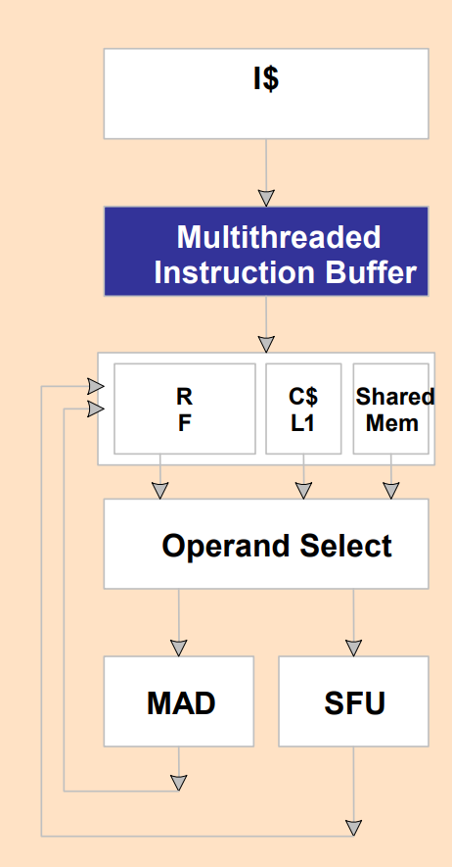
SM Instruction Buffer – Warp Scheduling
• Fetch one warp instruction/cycle
– from instruction cache
– into any instruction buffer slot
• Issue one “ready-to-go” warp instruction/cycle
– from any warp - instruction buffer slot
– operand scoreboarding used to prevent hazards
• Issue selection based on round robin or age of warp
• SM broadcasts the same instruction to 32 threads of a Warp

Slide 73
Scoreboarding
• How to determine if a thread is ready to execute?
• A scoreboard is a table in hardware that tracks
– instructions being fetched, issued, executed
– resources (functional units and operands) they need
– which instructions modify which registers
• Old concept from CDC 6600 (1960s)

Slide 74
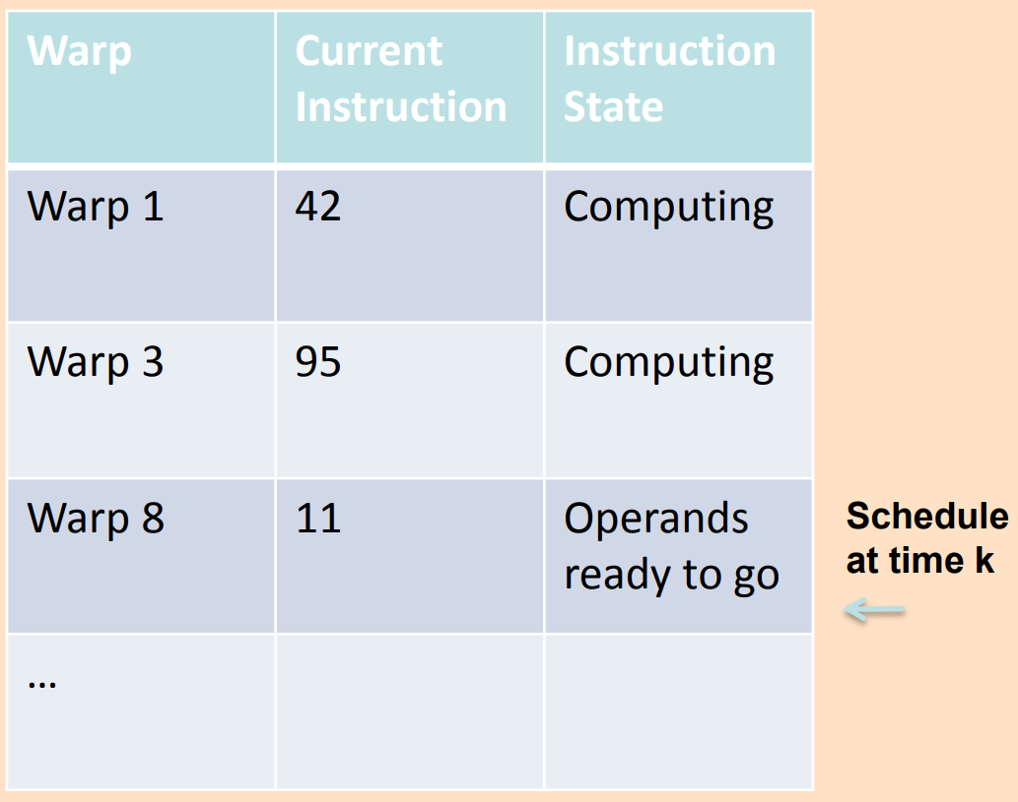
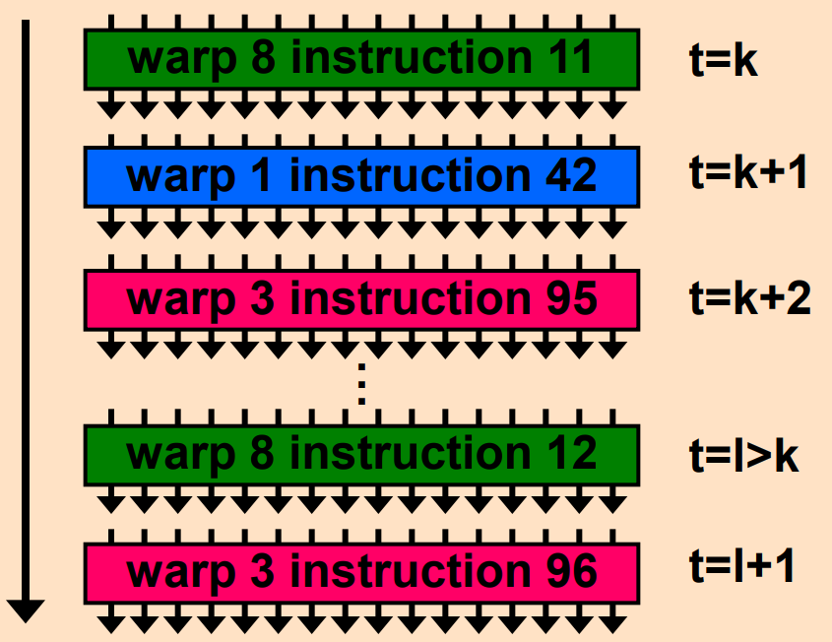
Scoreboarding Example
Consider three separate instruction streams: warp1,
warp3 and warp8

Slide 75
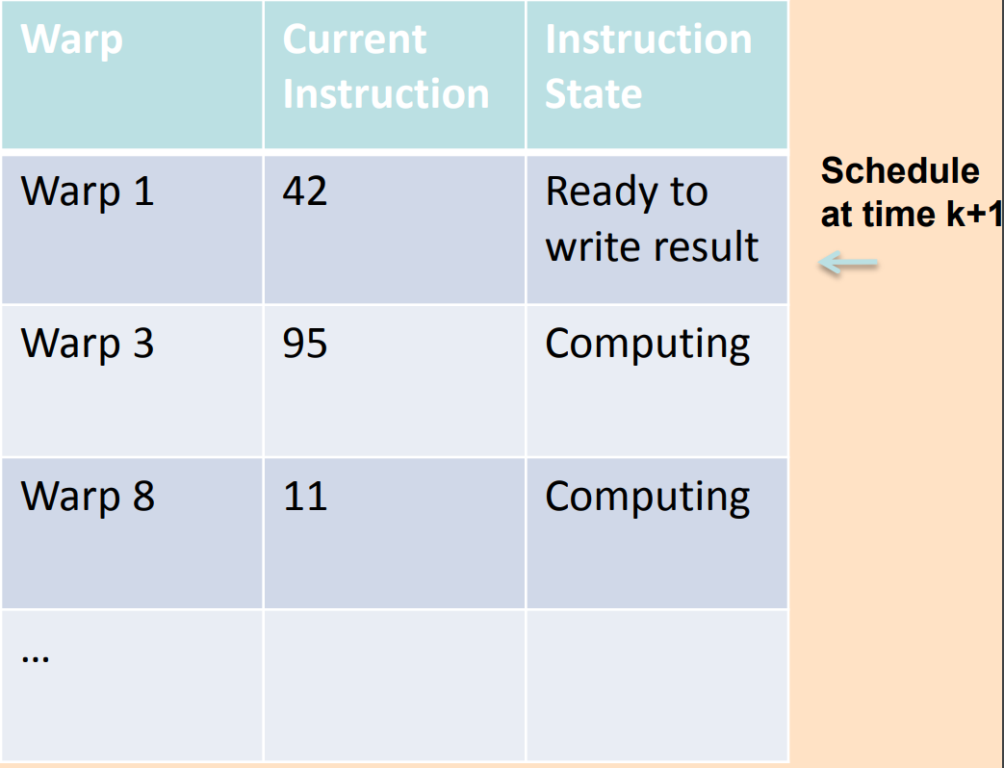
Scoreboarding Example
Consider three separate instruction streams: warp1,
warp3 and warp8

Slide 76
Threads Can Take Different Paths in Warp-based SIMD
每个线程可以包含控制流指令
这些线程可以执行不同的控制流路径
A
Thread Warp
Common PC
B
Thread
1
Thread
2
Thread
3
Thread
4
C
D
F
E
G
Slide credit: Tor Aamodt

Slide 77
Control Flow Problem in GPUs/SIMT
GPU 控制逻辑使用 SIMD流水线 以节省资源
这些标量线程构成warp
当一个WARP中的线程分支到不同的执行路径时，产生分支发散（Branch divergence）
Branch
Branch
Path A
Path A
Path B
Path B
与向量处理机模型的条件执行类似
（Vector Mask and Masked Vector Operations?）

Slide 78
Conditional Branching
与向量结构类似, GPU 使用内部的屏蔽字(masks)
还使用了 （SIMT-Stack）
分支同步堆栈
保存分支的路径地址
保存该路径的SIMD lane 屏蔽字(mask)
即指示哪些车道可以提交结果
指令标记(instruction markers）
管理何时分支（divergence）到多个执行路径，何时路径汇合(converge)
PTX层
CUDA线程的控制流由PTX分支指令(branch、call、return and exit）控制 以及
由程序员指定的每个线程车道的1-bit谓词寄存器
GPU硬件指令层,控制流包括：
分支指令(branch,jump call return)
特殊的指令用于管理分支同步栈
GPU硬件为每个SIMD thread 提供堆栈 保存分支的路径
GPU硬件指令带有控制每个线程车道的1-bit谓词寄存器

Slide 79
Branch divergence
硬件跟踪各µthreads转移的方向（判定哪些是成功的转移，哪些是失败的转移）
如果所有线程所走的路径相同，那么可以保持这种 SIMD 执行模式
如果各线程选择的方向不一致，那么创建一个屏蔽（mask） 向量来指示各线程的转移方向（成功、失败）
继续执行分支失败的路径，将分支成功的路径压入硬件堆栈（分支同步堆栈），待后续执行
SIMD 车道何时执行分支同步堆栈中的路径?
通过执行pop操作，弹出执行路径以及屏蔽字，执行该转移路径
SIMD lane完成整个分支路径执行后再执行下一条指令 称为converge(汇聚）
对于相同长度的路径，IF-THEN-ELSE 操作 的 效率平均为50%

Slide 80
Example
if (X[i] != 0)
X[i] = X[i] – Y[i];
else X[i] = Z[i];
ld.global.f64 RD0, [X+R8] ; RD0 = X[i]
setp.neq.s32 P1, RD0, #0 ; P1 is predicate register 1
@!P1, bra ELSE1, *Push ; Push old mask, set new mask bits
; if P1 false, go to ELSE1
ld.global.f64 RD2, [Y+R8] ; RD2 = Y[i]
sub.f64 RD0, RD0, RD2 ; Difference in RD0
st.global.f64 [X+R8], RD0 ; X[i] = RD0
@P1, bra ENDIF1, *Comp ; complement mask bits
; if P1 true, go to ENDIF1
ELSE1: ld.global.f64 RD0, [Z+R8] ; RD0 = Z[i]
st.global.f64 [X+R8], RD0 ; X[i] = RD0
ENDIF1: <next instruction>, *Pop ; pop to restore old mask

Slide 81
Branch Divergence Handling
A;
if (some condition) {
B;
} else {
C;
}
D;
One per warp
Control Flow Stack
Next PC
Recv PC
Active Mask
TOS
A
D
--
--
1111
1111
B
D
1110
A
C
C
D
0001
Execution Sequence
B
C
A
C
B
D
1
1
1
1
0
0
0
1
1
1
1
0
1
1
1
1
D
Time

Slide 82
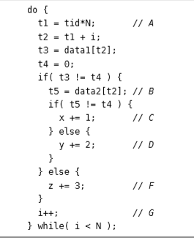
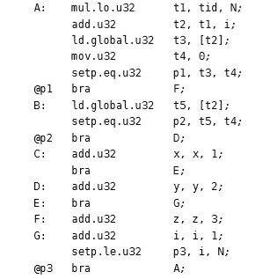
SIMT stack operation
Example CUDA C source code for illustrating SIMT stack operation
Example PTX assembly code for illustrating SIMT stack operation.

Slide 83
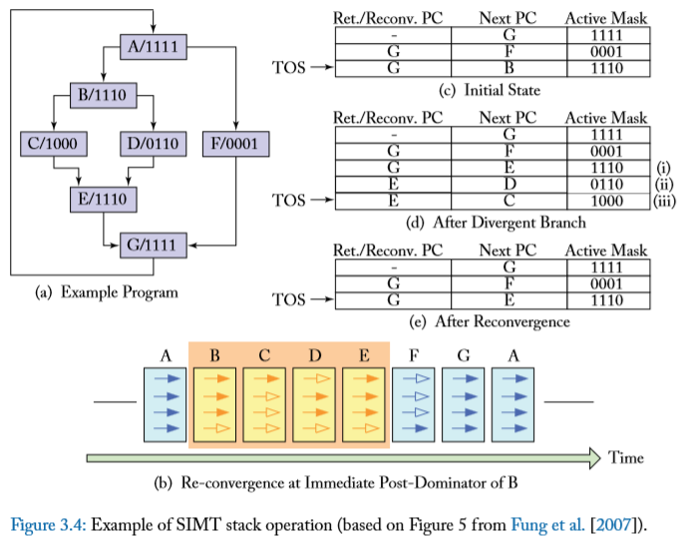

Slide 84
Remember: Each Thread Is Independent
SIMT 主要优点：
可以独立地处理线程,即每个线程可以在任何标量流水线上单独执行（ MIMD 处理模式）
可以将线程组织成warp，即可以将执行相同指令流的线程构成warp，形成SIMD 处理模式, 以充分发挥SIMD处理的优势
如果有许多线程，对具有相同PC值的线程可以将它们动态组织到一个warp中
这样可以减少“分支发散” →提高SIMD 利用率
SIMD 利用率: 执行有用操作的SIMD lanes的比例 (即, 执行活动线程的比例）

Slide 85
Dynamic Warp Formation/Merging
Idea: 分支发散之后，动态合并执行相同指令的线程
从那些等待的warp中形成新的warp
足够多的线程分支到每个路径，有可能创建完整的新warp
Warp X
Warp Z
Warp Y

Slide 86
Dynamic Warp Formation/Merging
Idea:
分支发散之后，动态合并执行相同指令的线程
Fung et al., “Dynamic Warp Formation and Scheduling for Efficient GPU Control Flow,” MICRO 2007.
Branch
Branch
Path A
Path A
Path B

Slide 87
Dynamic Warp Formation Example
A
x/1111
y/1111
Legend
B
A
A
x/1110
y/0011
Execution of Warp x
Execution of Warp y
at Basic Block A
at Basic Block A
C
x/1000
D
x/0110
F
x/0001
y/0010
y/0001
y/1100
D
E
A new warp created from scalar threads of both Warp x and y executing at Basic Block D
x/1110
y/0011
G
x/1111
y/1111
A
A
B
B
C
C
D
D
E
E
F
F
G
G
A
A
Baseline
Time
Dynamic
Warp
Formation
A
A
B
B
C
D
E
E
F
G
G
A
A
Time

Slide 88
Hardware Constraints Limit Flexibility of Warp Grouping
Functional Unit
Registers
for each
Thread
Registers for thread IDs
0, 4, 8, …
Registers for thread IDs
1, 5, 9, …
Registers for thread IDs
2, 6, 10, …
Registers for thread IDs
3, 7, 11, …
Can you move any thread
flexibly to any lane?
Lane
Memory Subsystem

Slide 89
When You Group Threads Dynamically
存储器访问如何处理？
固定模式的存储器访问相对简单，当动态构成warp时，使得访问模式具有随机性，使得问题变得复杂。→ 降低存储器访问的局部性
→ 导致存储器带宽利用率的下降

Slide 90
What About Memory Divergence?
现代 GPUs 包括高速缓存，减少对存储器的访问
Ideally: 一个warp中的所有线程的存储器访问都命中 (互相没有冲突）
Problem: 一个Warp中有些命中，有些失效
Problem: 一个线程的stall导致整个warp停顿
需要有相关技术来解决存储器发散访问问题

Slide 91
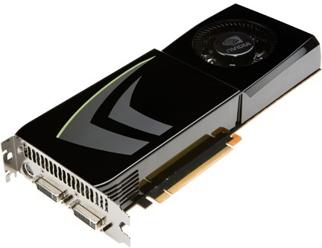
NVIDIA GeForce GTX 285
NVIDIA-speak:
240 stream processors
“SIMT execution”
Generic speak:
30 cores
8 SIMD functional units per core

Slide 92
NVIDIA GeForce GTX 285 “core”
64 KB of storage
for thread contexts (registers)
…
= SIMD functional unit, control
shared across 8 units
= instruction stream decode
= multiply-add
= execution context storage
= multiply
Notes:
30 * 32 * 32 = 30 * 1024 = 30K fragments
64KB register file = 16 32-bit registers per thread = 64B (1/32 that of LRB)
16KB of shared scratch
80KB / core available to software

Slide 93
NVIDIA GeForce GTX 285 “core”
64 KB of storage
for thread contexts (registers)
…
Groups of 32 threads share instruction stream (each group is a Warp)
Up to 32 warps are simultaneously interleaved
Up to 1024 thread contexts can be stored
Notes:
To get maximal latency hiding:
Run 1/32 of the time
16 words per thread = 64B

Slide 94
NVIDIA GeForce GTX 285
Tex
Tex
…
…
…
…
…
…
Tex
Tex
…
…
…
…
…
…
Tex
Tex
…
…
…
…
…
…
Tex
Tex
…
…
…
…
…
…
Tex
Tex
…
…
…
…
…
…
30 cores on the GTX 285: 30,720 threads
Notes:
If you’re running a CUDA program, and your not launching 30K threads, you are certainly not getting full latency hiding, and you might not be using the GPU well

Slide 95
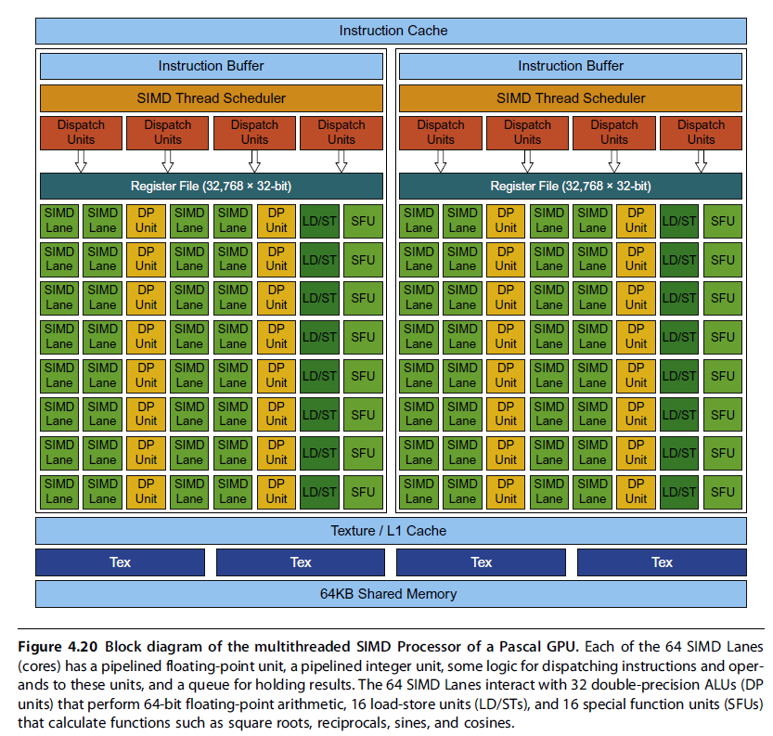
GP100 GPU
56 SMs
64 Lanes/SM
Or
3584
Stream Processors

Slide 96
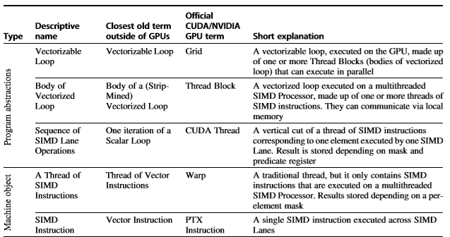
Summary- 向量处理机 vs. GPU
不同层次相近的术语比较

Slide 97
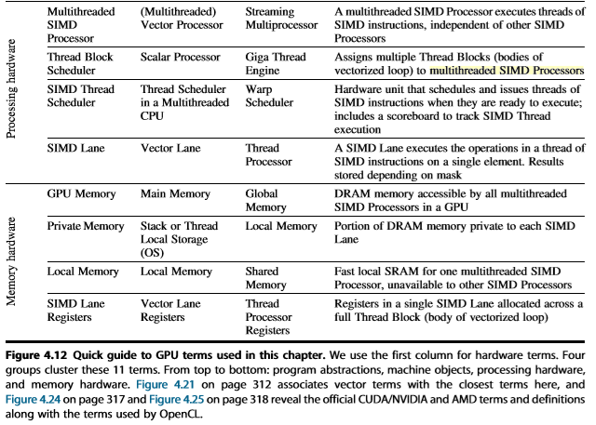
Summary-向量处理机 vs. GPU

Slide 98
Acknowledgements
These slides contain material developed and copyright by:
John Kubiatowicz (UCB)
Krste Asanovic (UCB)
John Hennessy (Standford)and David Patterson (UCB)
Chenxi Zhang (Tongji)
Muhamed Mudawar (KFUPM)
UCB material derived from course CS152、CS252、CS61C
KFUPM material derived from course COE501、COE502
CMU Introduction to Computer Architecture
http://www.ece.cmu.edu/~ece447/

